Slide 1
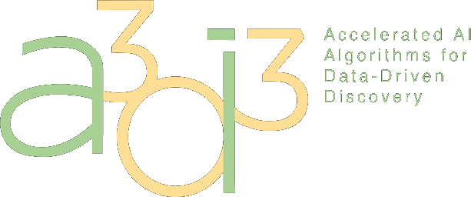
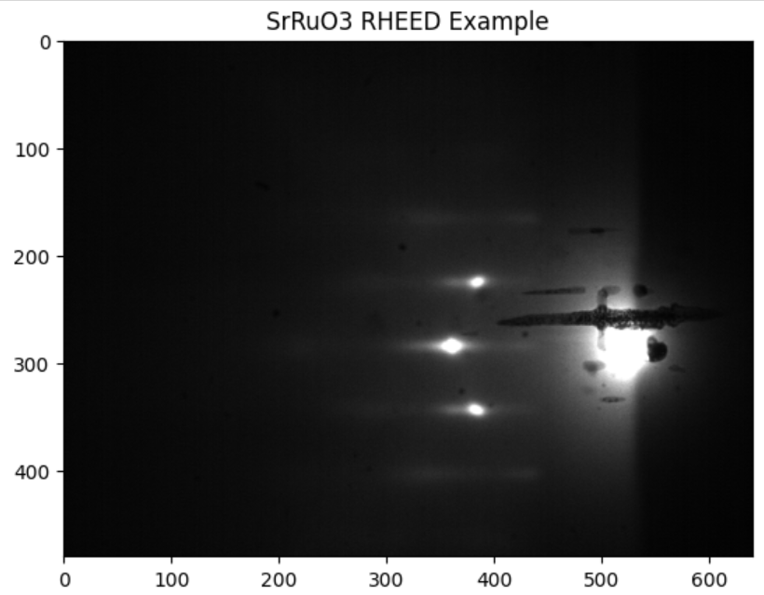
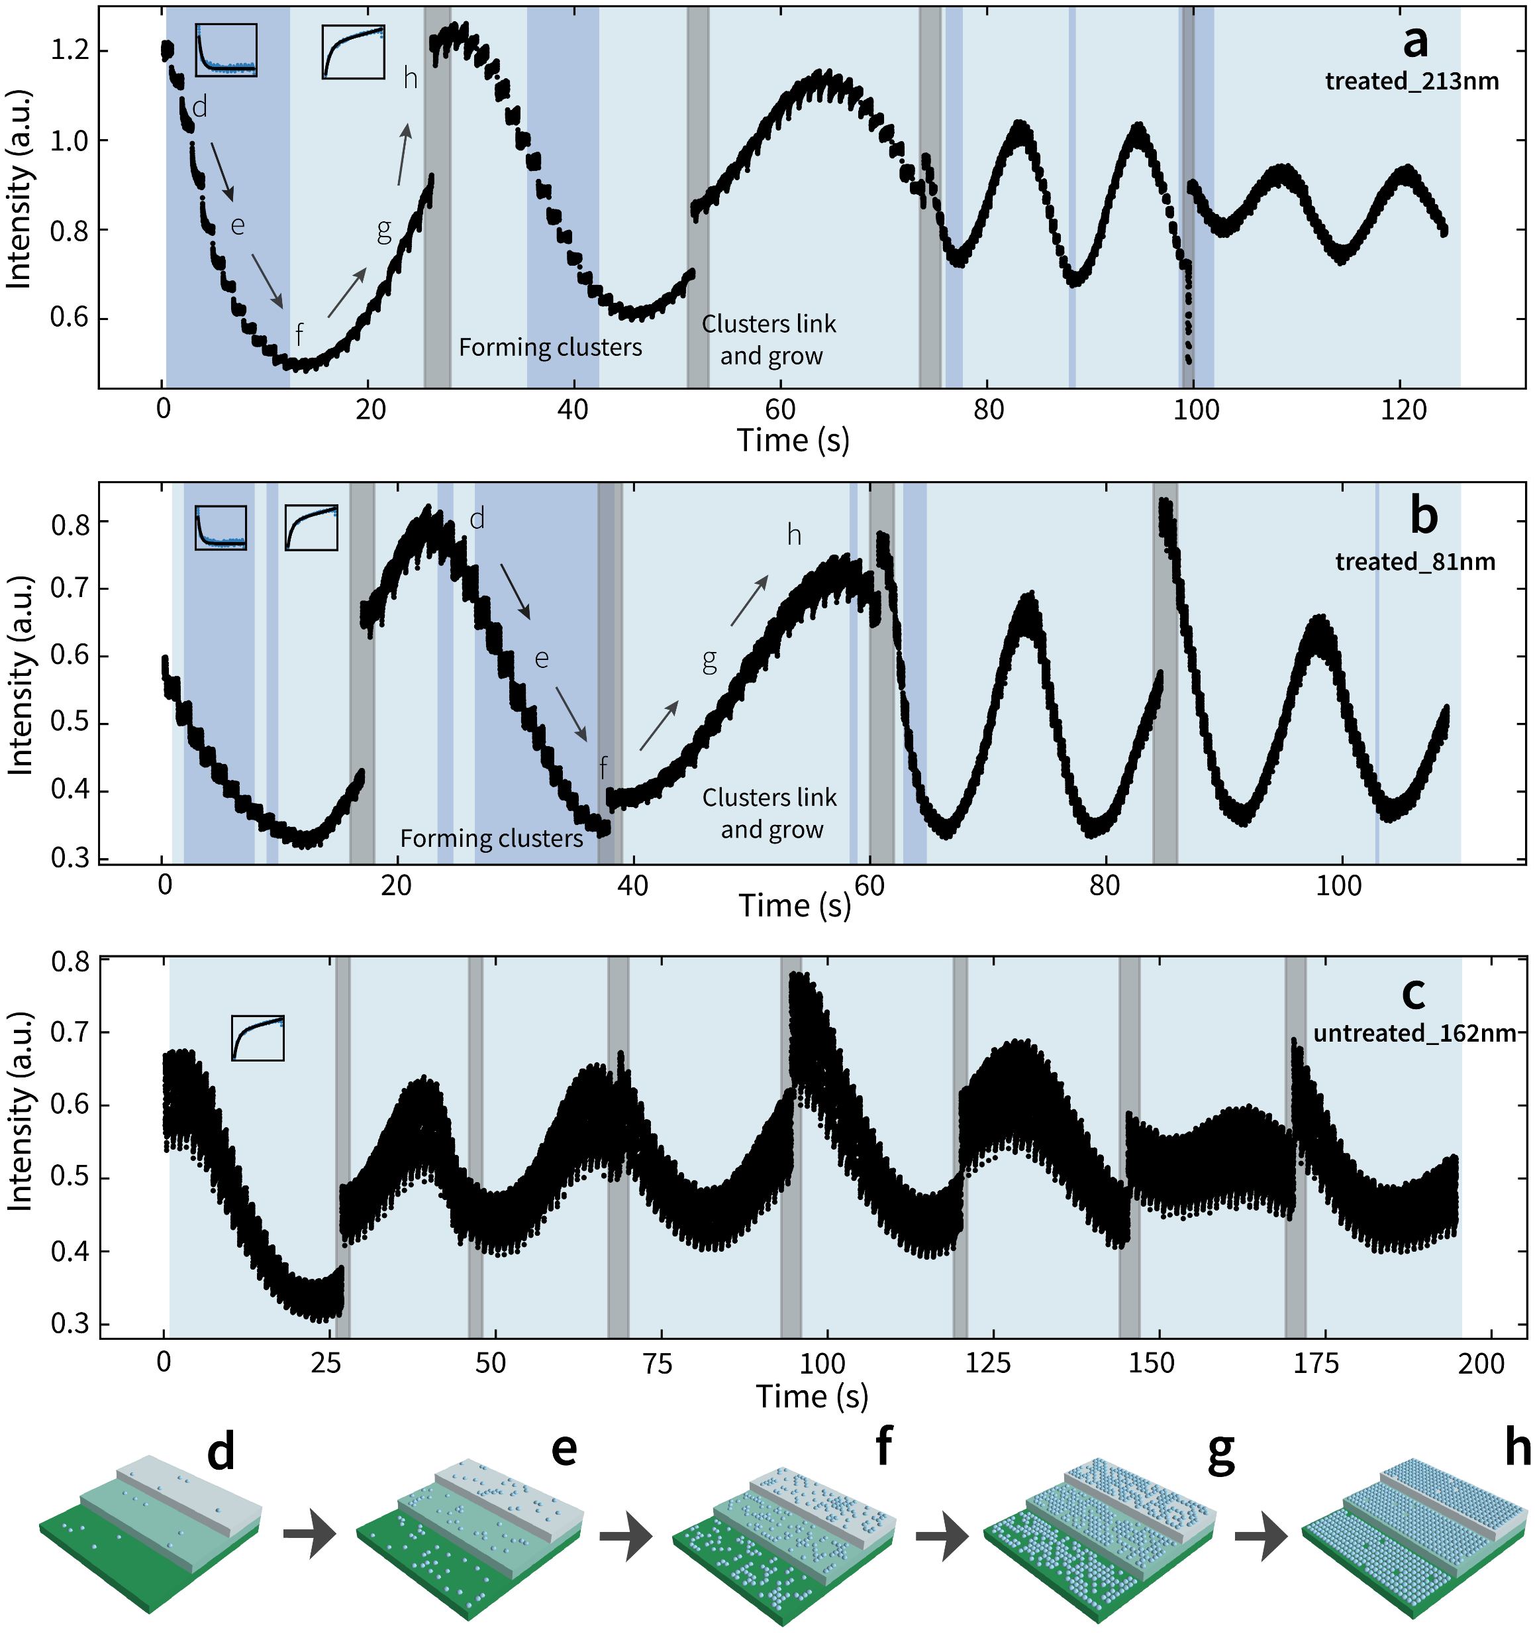
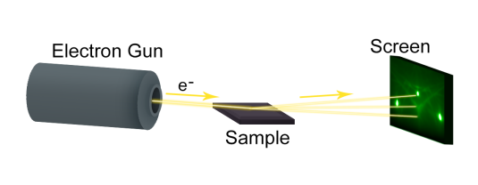
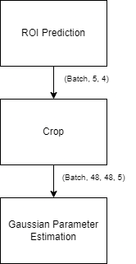
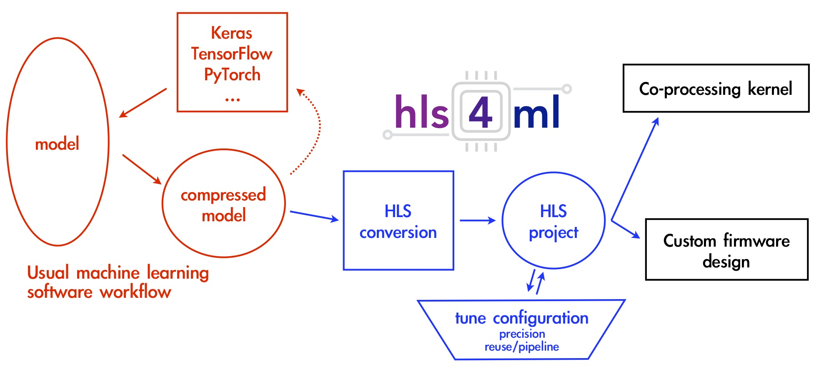
Accelerating RHEED Analysis with FPGA-Optimized Neural Networks
Yichen Guo, Joshua Agar (Drexel University)
Matt Wilkinson, Pujan Patel, Scott Hauck, Shih-Chieh Hsu, Geoff Jones (University of Washington)
Introduction
Method
Gaussian Parameter Estimation
Reflection High Energy Electron Diffraction (RHEED) uses electron diffraction to monitor thin film growth and surface structure in real-time during deposition.
Spots are modeled as gaussians by predicting μx, μy​, σx^2, σy^2, and θ with a CNN
True Single Spot Image
Estimated Parameter Reconstruction
An electron beam is directed at a surface, and the resulting diffraction pattern reveals information about the surface structure and crystalline quality.
Training loss of 0.0005566 when comparing the original image to a reconstructed image with a MSE loss
Goal
YOLO-style CNN to predict bounding boxes for spots
Deploy a machine learning based RHEED analysis on an FPGA using HLS4ML to provide real time insights and lower costs.
Next Steps
> Train a unified python model (Keras crop) and test the accuracy and resource usage against the two separate model approach (hardware crop)
> Design a system to provide real-time control feedback to the deposition
Either in hardware or a custom Keras layer to lower resources used
References
NSF: MRI: Development of Heterogeneous Edge Computing Platform for Real-Time Scientific Machine Learning (2215789)
NSF: MRI: Development of a Platform for Accessible Data-Intensive Science and Engineering (2320600)
DOE: Real-time Data Reduction Codesign at the Extreme Edge for Science
ARL: Collaborative for Hierarchical Agile and Responsive Materials (CHARM) (W911NF-19-2-0119)
Run the crops through the same set of layers
[1] J. Duarte et al 2018 JINST 13 P07027
[1]
Submission #126
Notes:
128/256 is how many times the DSPs are divided by, to see resource usage and performance change
Implementing an HLS4ML inspired by system Verilog
In previous work, HLS4ML better, extended to 2d conv, but for stride 2 is not optimized, working on batch norm
One diagram chart to summarize previous work

