Slide 1
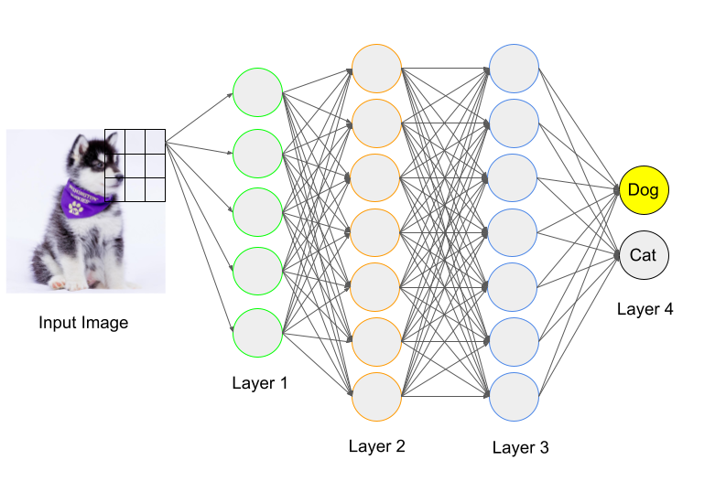
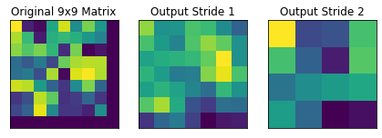
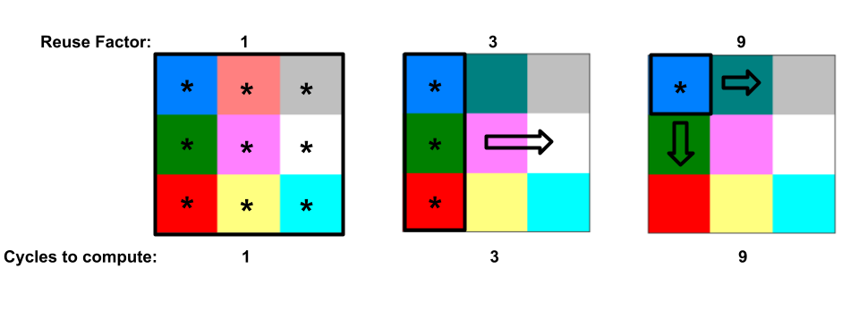
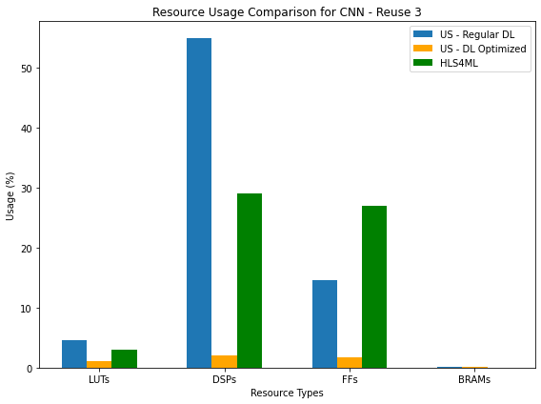
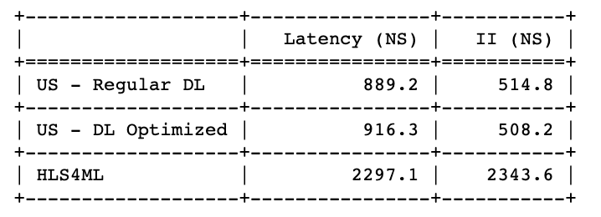
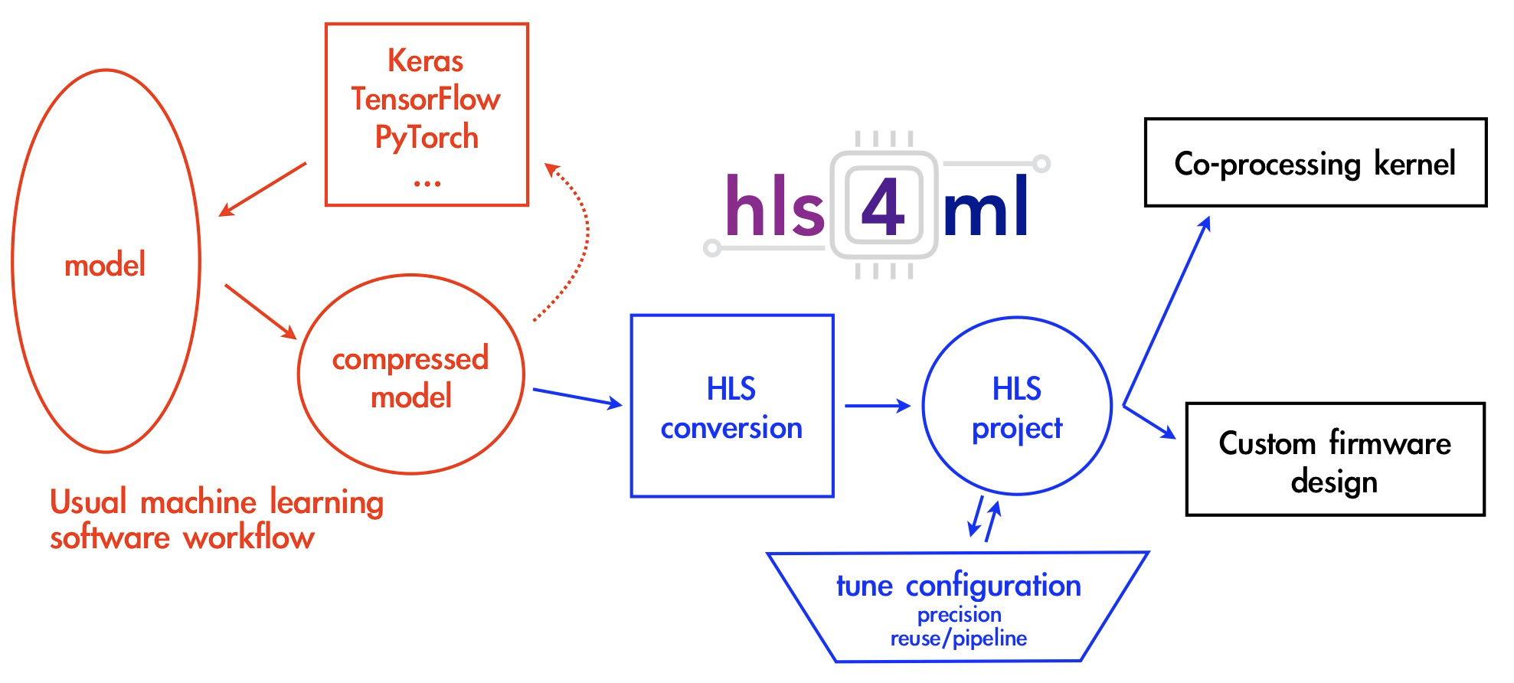
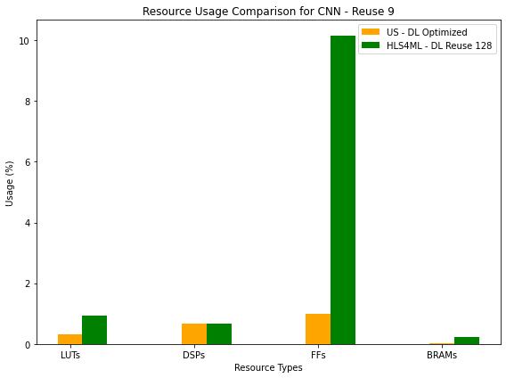
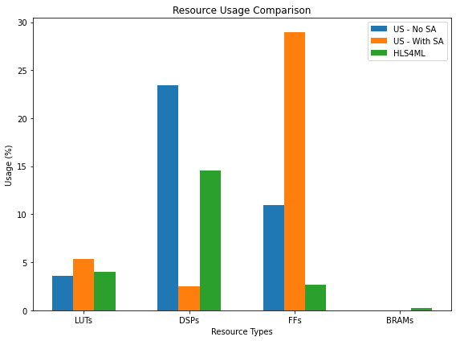
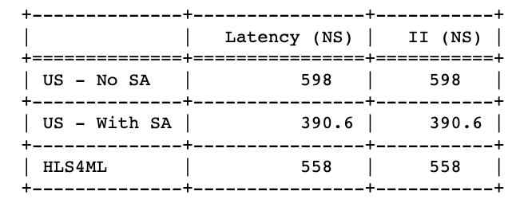
Evaluating the Quality of HLS4ML's CNN Implementations on FPGAs
Caroline Johnson, Waiz Khan, Matthew Bavier, Oleh Kondratyuk, Trinh Nguyen, Stephany Ayala-Cerna, Aidan Short, Anatoliy Martynyuk, Scott Hauck, Shih-Chieh Hsu, and Geoff Jones
NSF #2117997
Machine Learning & FPGAs
CNN Parameters
Complex CNN
Machine learning requires fast computation over large datasets.
Regular computers are easy to program but not fast enough.
Field Programmable Gate Arrays (FPGAs) are hard to program but much faster.
Stride:
Reuse Factor:
Stride of 2 and Reuse of 3 & 9
Hand optimizations done:
Complex CNN: Utilize BRAM to store data and have an FSM control the indices to read from – simplifies data processing.
Optimized Dense Latency (DL) Layer: Compute Dense Latency at the same time as the convolution layer – use less resources and finish computation faster.
HLS4ML
Basic CNN
Takeaways:
DL Optimized increases performance with less resources, max resource usage of 2% versus 29%
Complex CNN allows computation to be done ~4x faster
High Level Synthesis for Machine Learning (HLS4ML) enables rapid prototyping of Machine Learning models into hardware designs.
Stride of 1 and Reuse of 1
Hand optimizations done:
Shift Add (SA) Module: When multiplying by a constant, see if it can be done with shifters (utilizes LUTs) instead of multiplication (utilizes DSPs). Example: x * 6 = x << 1 + x << 2
Takeaways:
Results of Fast CNN performing better holds for reuse of 9
Increasing the reuse factor of HLS4ML's DL, like our optimized DL, makes the model about 4x slower and max resource, FFs, increases by 10x
[1]
Our Goal
Determine the efficiency of HLS4ML by comparing to hand-written designs.
Efficiency is determined by:
Performance Latency: how long to get one output Initiation Interval (II): how long between successive outputs
Max Resource Usage DSPs: multipliers LUTs: compute logic FFs: hold onto data between cycles BRAMs: large memory units
Next Steps
Implement new adjusted stride and reuse factor CNN in HLS4ML
Implement Optimized Dense Latency in HLS4ML
Explore other layers in HLS4ML, example: Batch Normalization
Takeaways: By being able to optimize for DSPs used: 1. 5.8% less DSPs used than HLS4ML
2. Tradeoff of FFs used and performance with 2.6x more FFs used but a 1.4x performance increase over HLS4ML
References
[1] J. Duarte et al 2018 JINST 13 P07027
Notes:
Horizontal Version

