Slide 1
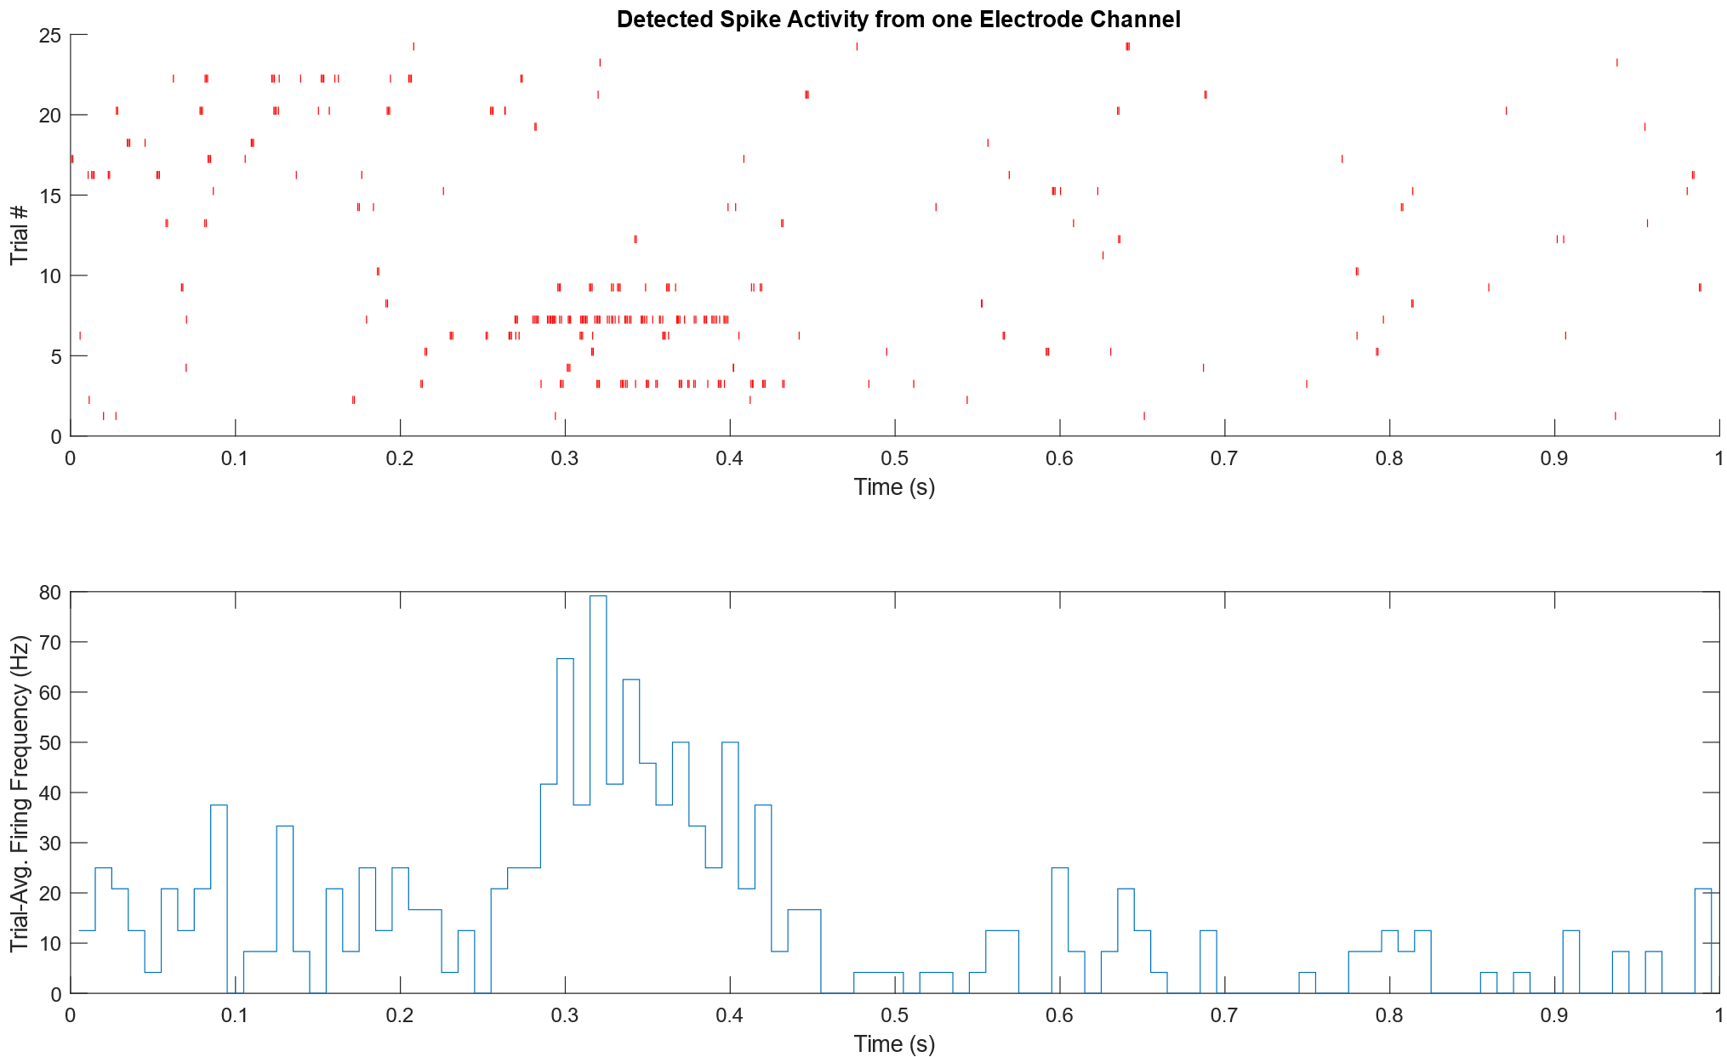
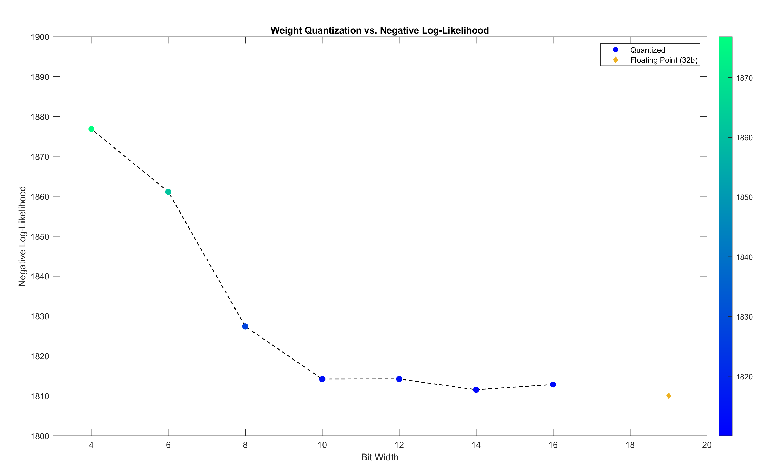
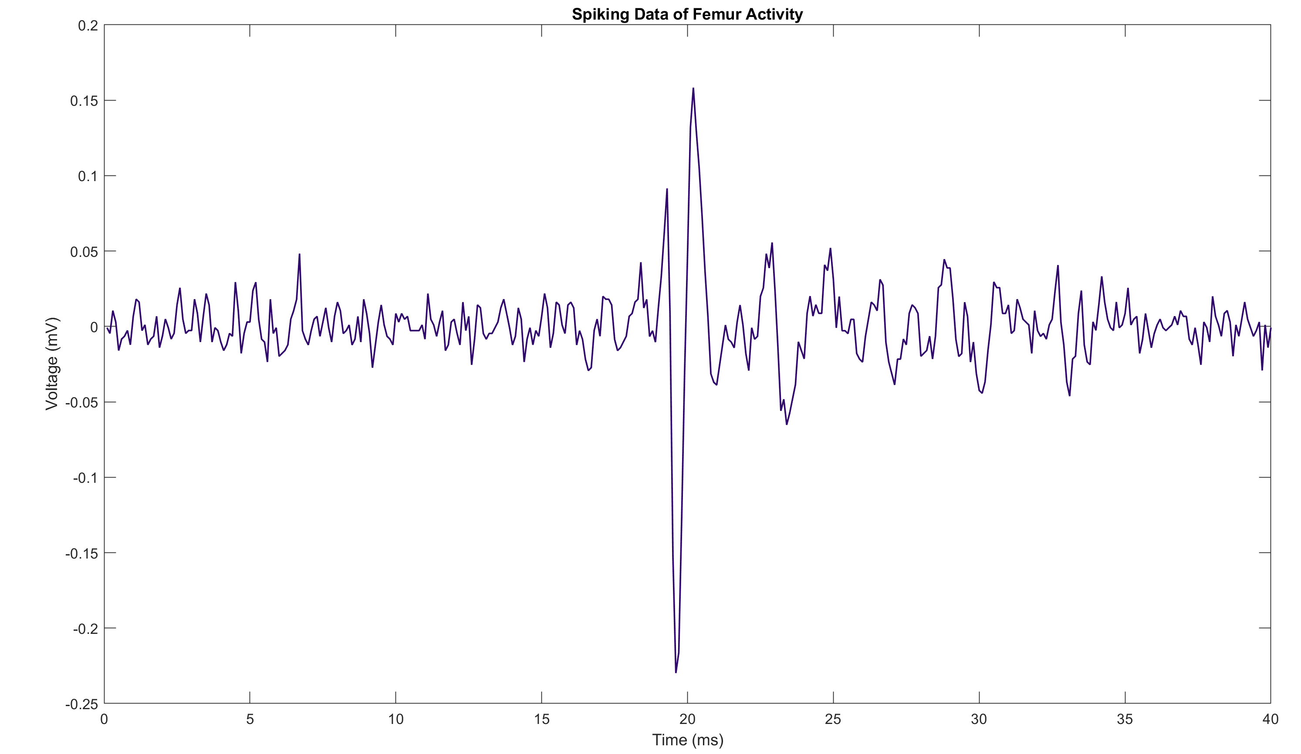
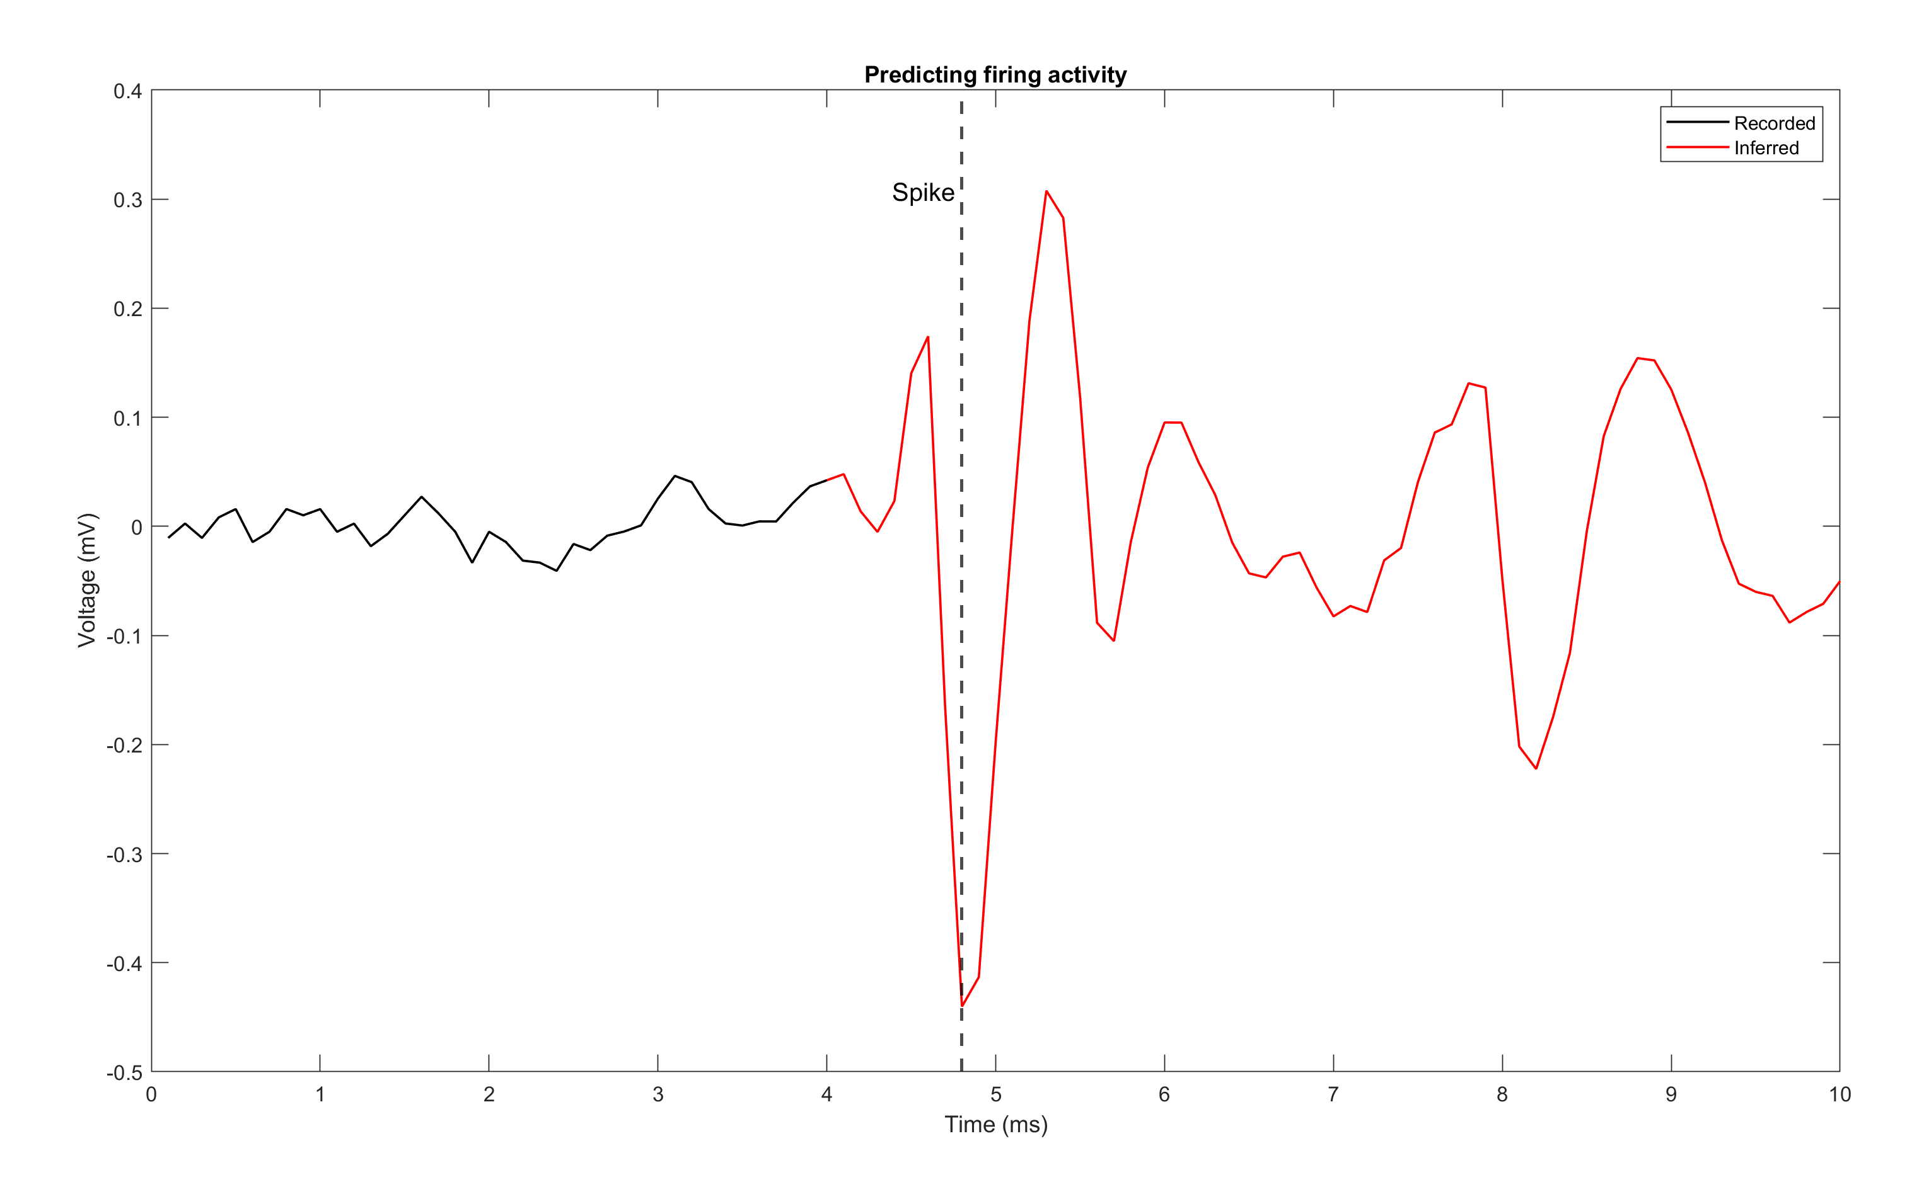
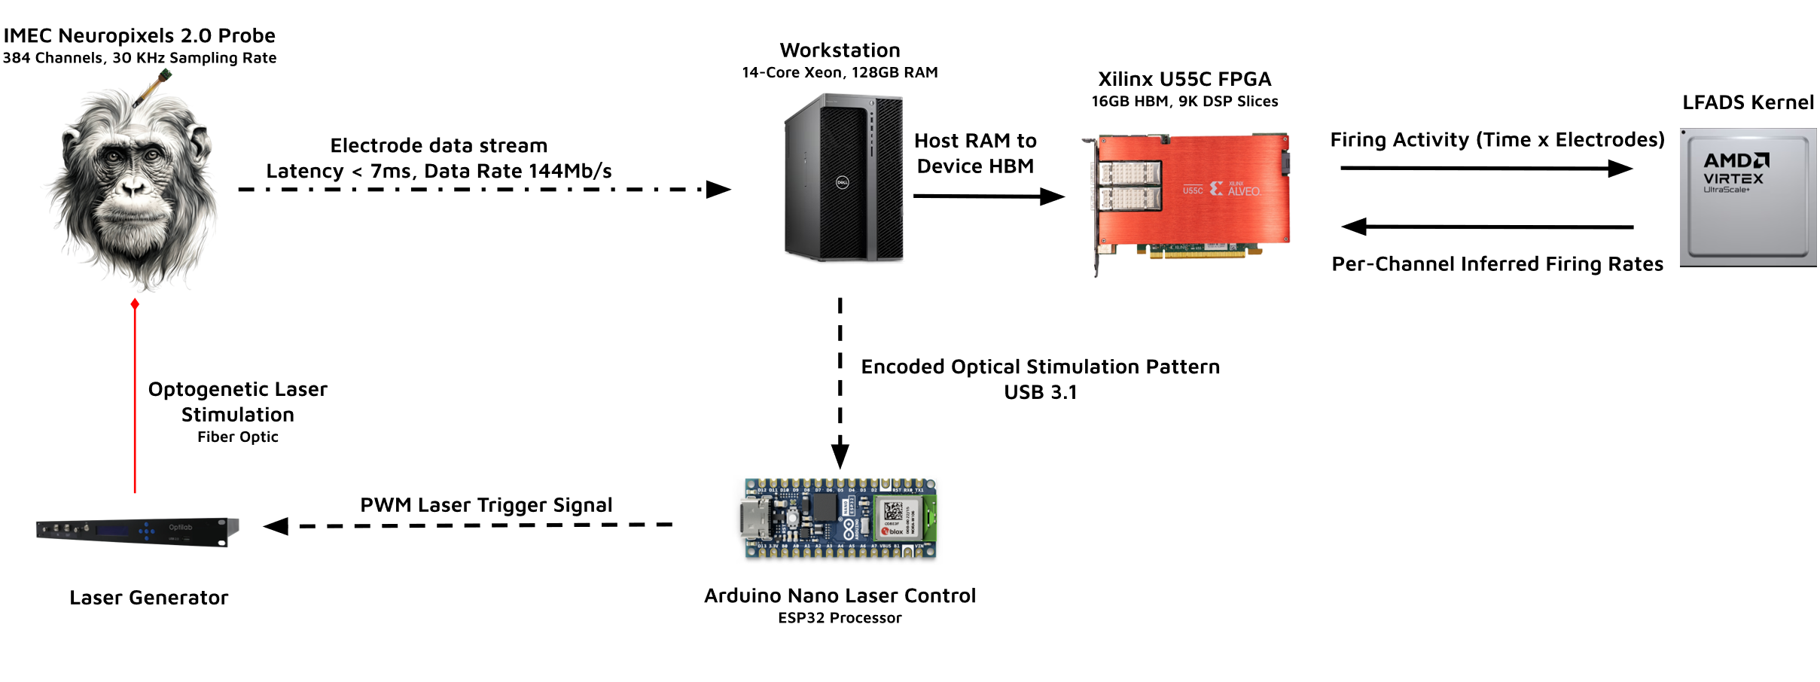
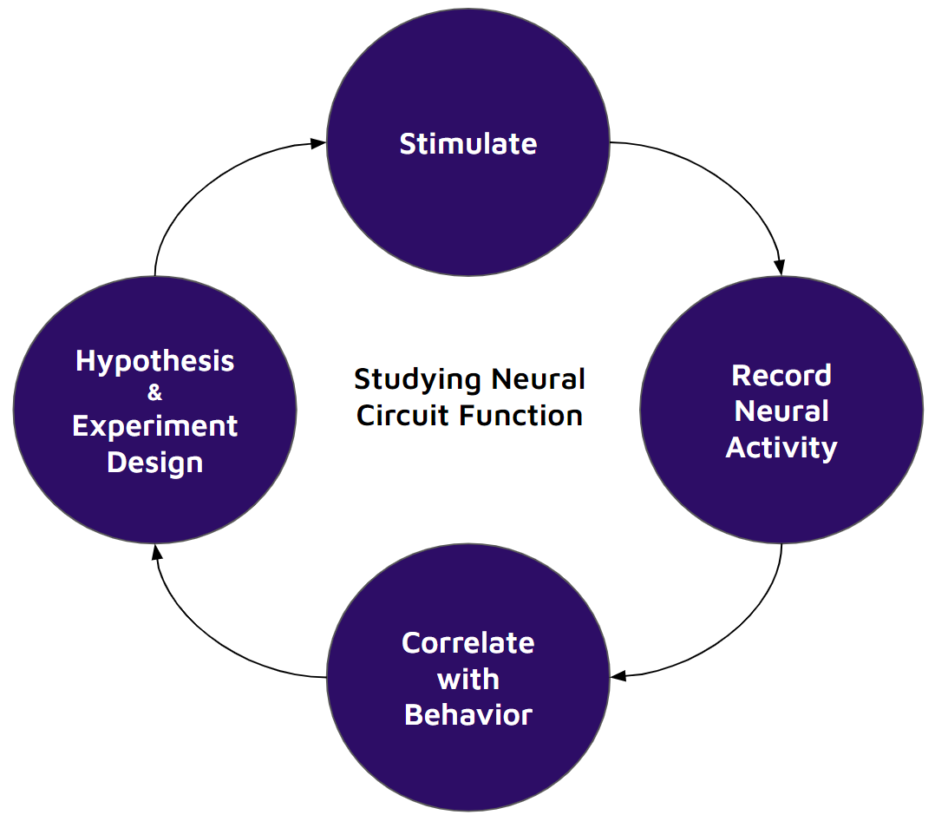
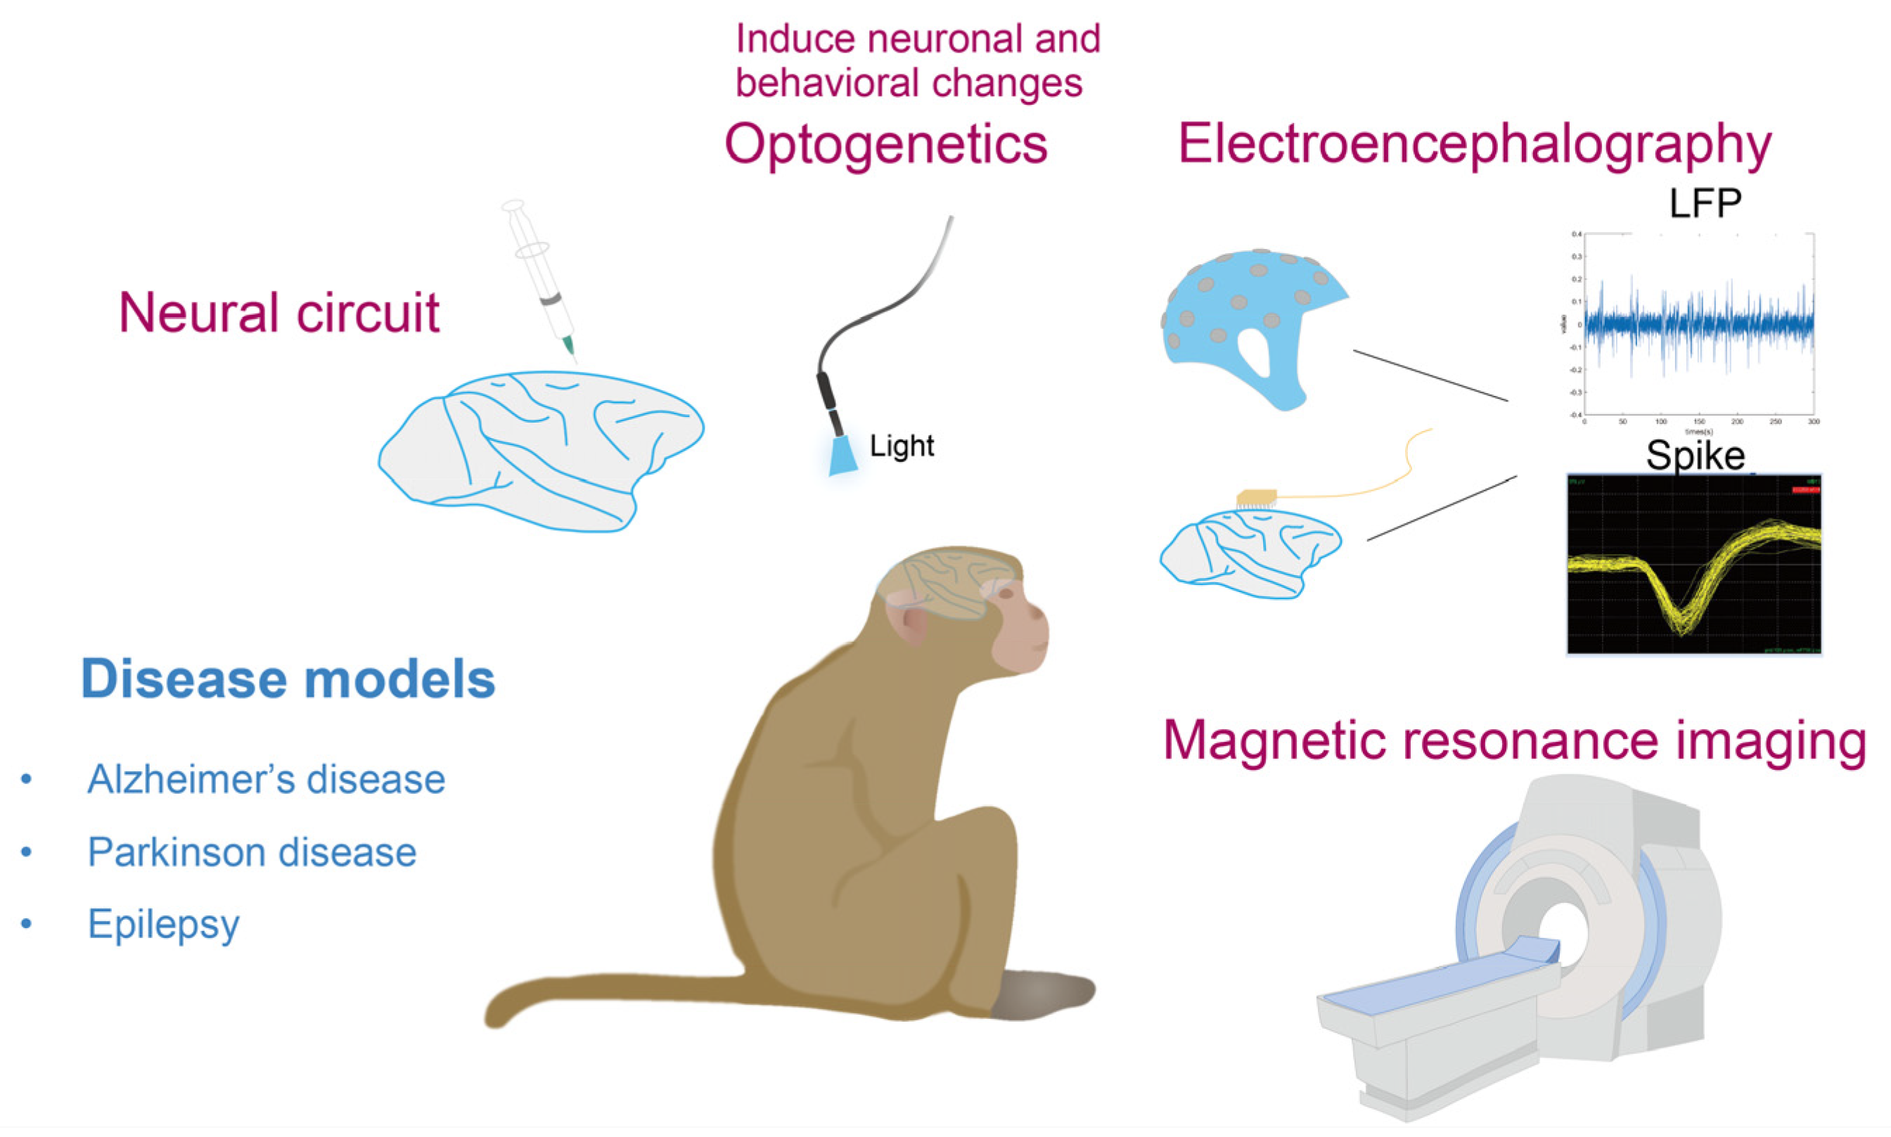
Closed-loop Brain Stimulation in NHPs
Using Hardware Accelerated Machine Learning
Rajeev B. Botadra¹, ChiJui Chen⁵, Leo Scholl¹, Trung Le¹, Hao Fang¹, Ryan Canfield², Amy Orsborn¹, Eli Shlizerman³, Shih-Chieh Hsu⁴, Scott Hauck¹
NSF-2117997
Stimulating the Brian
Decoding Neural Activity
Latency Constraint & FPGAs
Decoder Accuracy
Electric stimuli can incite/inhibit neuron activity
Occurs over an order of milliseconds
Need a system that operates within latency constraint to effectively target brain regions
LFADS – a Variation Autoencoder – models firing activity in brain regions
[2]
Decoded brain states inform the stimulation pattern to inhibit neurons and observe the response
Higher firing activity during stimulation can constrain inference latencies to <20ms (1/F)
Modern CPUs and GPUs fail to meet this constraints on sequential architectures, so we look to FPGAs
The pre-trained LFADS model weights were quantized with QAT
LFADS Kernel resource utilization on U55C
Motivations
Creating closed-loop Brain-Computer Interfaces (BCIs) for Prosthetics
Studying neuron circuits and their contributions to behavior for Neurotherapy
NHPs are ideal candidates of study for their physiological similarities to humans
[1]
System Design
The existing experimental apparatus was modified to integrate the FPGA and build an online closed-loop system
Raw field potentials are preprocessed into spikes before decoding
LFADS kernel deploys a fine-tuned and quantized architecture
Future Works
Test and deploy additional model architectures (NDT, MRAE, modified LFADS)
Leverage closed-loop capability in experiment design
Investigating motion pre-planning through the hand-reach-out task
References
[1] Nan Qiao, et al. “Update on Nonhuman Primate Models of Brain Disease and Related Research Tools.” MDPI Biomedicines, 2023.
[2] Xiaohan Liu, et al. “Sleep Spindles as a Driver of Low Latency, Low Power ML in HLS4ML & TinyML.” University of Washington, 2023.
¹Electrical & Computer Engineering, University of Washington
²Bioengineering, University of Washington
³Applied Mathematics, University of Washington
⁴Physics, University of Washington
⁵Electrical Engineering, National Yang Ming Chiao Tung University

