Slide 1

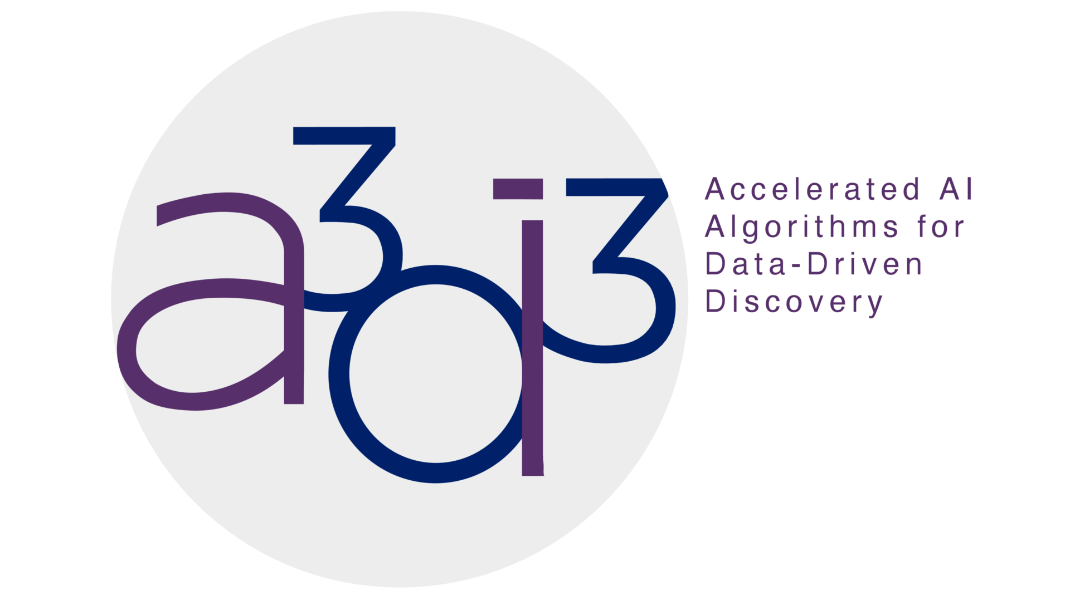

Neural Network Efficiency Evaluation on the
AMD Versal AI Engine
Yilin Shen, Caroline Johnson, Scott Hauck (University of Washington)
Introduction
Models for Evaluation
Comparison Results
The smaller, the better!
AI deployment requires hardware assistance (CPU/GPU/FPGA, etc.)
FPGA is a popular solution for its low latency
Next-gen FPGA (AMD Versal) introduced AI Engine(AIE)
1-D model structure
1-D model Results
The AIE looks promising:
2-D model structure
2-D model Results
AI Engine Implementation
Conclusion
If throughput and latency is the priority, go for FPGA
If cost or replication is the priority, go for FPGA
AIE saves silicon area and power for basic ML workload
Future Work
Should we use it? Let’s compare AIE to FPGA!
Map more complex models
  Convolution with stride
  Multi-channel convolution
Evaluate AIE-ML: next-gen AIE
  Optimized interconnection and enhanced MAC unit
Metrics for Evaluation
1-D model AIE mapping
Initiation interval (1/throughput)
Latency
Power
Price
Resource utilization
Silicon Area utilization
Reference
2-D model AIE mapping
[1] Johnson, Caroline. Evaluating the Quality of HLS4ML’s Basic Neural Network Implementations on FPGAs. MS thesis. University of Washington, 2023.
The smaller, the better!
* FPGA Implementation: see [1]
NSF Grant 2117997

