Slide 1
Active Semi-Supervised Learning using Submodular Functions
Andrew Guillory, Jeff Bilmes
University of Washington

Slide 2
Given unlabeled data
for example, a graph

Slide 3
Learner chooses a labeled set $L⊆V$

Slide 4
Nature reveals labels $yL∈\left\{0, 1\right\}L$
-
+

Slide 5
Learner predicts labels $\hat{y}∈\left\{0,1\right\}V$
-
+
+
+
-
-
-
+
-
+
+

Slide 6
Learner suffers loss $\left\|\hat{y}−y\right\|1$
-
-
+
+
+
+
-
-
-
+
+
-
-
+
+
+
-
-
+
+
-
+
Predicted
Actual
$\left\|\hat{y}−y\right\|1 =2$

Slide 7
Basic Questions
What should we assume about $y$?
How should we predict $\hat{y}$ using $yL$?
How should select $L$?
How can we bound error?

Slide 8
Outline
Previous work: learning on graphs
More general setting using submodular functions
Experiments

Slide 9
Learning on graphs
What should we assume about $y$?
Standard assumption: small cut value
$Φ\left(y\right)=\sum_{i<j}{\left(y_{i}−y_{j}\right)2 Wi,j}$
A “smoothness” assumption
-
+
+
+
-
-
-
$$Φ\left(y\right)=2$$
+
-
+
+

Slide 10
Prediction on graphs
How should we predict $\hat{y}$ using $yL$?
Standard approach: min-cut (Blum & Chawla 2001)
Choose $\hat{y}$ to minimize $Φ(\hat{y})$ s.t. $\hat{y}L=yL$
Reduces to a standard min-cut computation
-
+
-
+
+
-
-
-
+
+
+
+
-

Slide 11
Active learning on graphs
How should select $L$?
In previous work, we propose the following objective
$$Ψ\left(L\right)= \min_{T⊆V∖L :T≠∅}{\frac{Γ(T)}{|T|}}$$
where $Γ\left(T\right)$ is cut value between $T$ and $V∖T$
Small $Ψ\left(L\right)$ means an adversary can cut away many points from $L$ without cutting many edges
Ψ(L) = 1/8
Ψ(L) = 1

Slide 12
Error bound for graphs
How can we bound error?
Theorem (Guillory & Bilmes 2009): Assume $\hat{y}$ minimizes $Φ(\hat{y})$ subject to $\hat{y}L=yL$. Then
$\left\|\hat{y}−y\right\|1≤2\frac{Φ(y)}{Ψ(L)}$
Intuition: $Error≤\frac{Complexity of true labels}{Quality of labeled set}$
Note: Deterministic, holds for adversarial labels

Slide 13
Drawbacks to previous work
Restricted to graph based, min-cut learning
Not clear how to efficiently maximize $Ψ\left(L\right)$
Can compute in polynomial time (Guillory & Bilmes 2009)
Only heuristic methods known for maximizing
Cesa-Bianchi et al 2010 give an approximation for trees
Not clear if this bound is the right bound

Slide 14
Our Contributions
A new, more general bound on error parameterized by an arbitrarily chosen submodular function
An active, semi-supervised learning method for approximately minimizing this bound
Proof that minimizing this bound exactly is NP-hard
Theoretical evidence this is the “right” bound

Slide 15
Outline
Previous work: learning on graphs
More general setting using submodular functions
Experiments

Slide 16
Submodular functions
A function $F(S)$defined over a ground set $V$ is submodular iff for all $A⊆B⊆\left(V∖\left\{v\right\}\right)$
$$F\left(A+v\right)−F \left(A\right)≥F\left(B+v\right)−F\left(B\right)$$
Example:
Real World Examples: Influence in a social network (Kempe et al. 03), sensor coverage (Krause, Guestrin 09), document summarization (Lin, Bilmes 11)
$F(S)$ is symmetric if $F\left(S\right)=F(V∖S)$

Slide 17
Submodular functions for learning
$Γ\left(T\right)$ (cut value) is symmetric and submodular
This makes $Γ\left(T\right)$ “nice” for learning on graphs
Easy to analyze
Can minimize exactly in polynomial time
For other learning settings, other symmetric submodular functions make sense
Hypergraph cut is symmetric, submodular
Mutual information is symmetric, submodular
An arbitrary submodular function $F$ can be symmetrized
$$Γ\left(S\right)=F\left(S\right)+F\left(V∖S\right)−F(V)$$

Slide 18
Generalized error bound
Theorem: For any symmetric, submodular $Γ(S)$, assume $\hat{y}$ minimizes $Φ(\hat{y})$ subject to $\hat{y}L=yL$. Then
$\left\|\hat{y}−y\right\|1≤2\frac{Φ(y)}{Ψ(L)}$
$Φ$ and $Ψ$ are defined in terms of $Γ$, not graph cut
$$Φ\left(y\right)=Γ\left(Vy=1\right) Ψ\left(S\right)= \min_{T⊆V∖S :T≠∅ }{\frac{Γ(T)}{|T|}}$$
Each choice of $Γ$ gives a different error bound
Minimizing $Φ(\hat{y})$ s.t. $\hat{y}L=yL$ can be done in polynomial time (submodular function minimization)

Slide 19
Can we efficiently maximize $Ψ$?
Two related problems:
1. Maximize $Ψ(L)$ subject to $\left|L\right|<k$
2. Minimize $|L|$ subject to $Ψ\left(L\right)≥λ$
If $Ψ(L)$ were submodular, we could use well known results for greedy algorithm:
$\left(1 −\frac{1}{e}\right)$ approximation to (1) (Nemhauser et al. 1978)
$1+ \ln{F(V)}$ approximation for (2) (Wolsey 1981)*
Unfortunately $Ψ(L)$ is not submodular
*Assuming integer valued $F$

Slide 20
Approximation result
Define a surrogate objective $Fλ(S)$ s.t.
$Fλ(S)$ is submodular
$Fλ\left(S\right)≥0$ iff $Ψ\left(S\right)≥λ$
In particular we use
$Fλ\left(S\right)=\min_{T⊆V∖S : T≠∅}Γ\left(T\right)−λ|T|$
Can then use standard methods for $Fλ(S)$
Theorem: For any integer, symmetric, submodular $Γ(S)$, integer $λ$, greedily maximizing $Fλ(L)$ gives $L$ with $Ψ\left(L\right)≥λ$ and $\left|L\right|≤\left(1+ \ln{λ}\right)\min_{L :Ψ\left(L\right)≥λ }{|L|}$

Slide 21
Can we do better?
Is it possible to maximize $Ψ(L)$ exactly?
Probably not, we show the problem is NP-Complete
Holds also if we assume $Γ(S)$ is the cut function
Reduction from vertex cover on fixed degree graphs
Corollary: no PTAS for min-cost version
Is there a strictly better bound?
Not of the same form, up to the factor 2 in the bound.
Holds without factor of 2 for slightly different version
No function larger than $Ψ(L)$ for which the bound holds
Suggests this is the “right” bound

Slide 22
Outline
Previous work: learning on graphs
More general setting using submodular functions
Experiments

Slide 23
Experiments: Learning on graphs
With $Γ(S)$ set to cut, we compared our method to random selection and the METIS heuristic
We tried min-cut and label propagation prediction
We used benchmark data sets from Semi-Supervised Learning, Chapelle et al. 2006 (using knn neighbors graphs) and two citation graph data sets

Slide 24
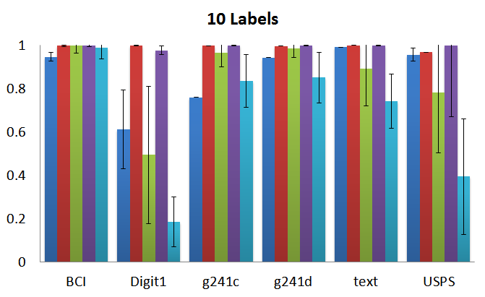
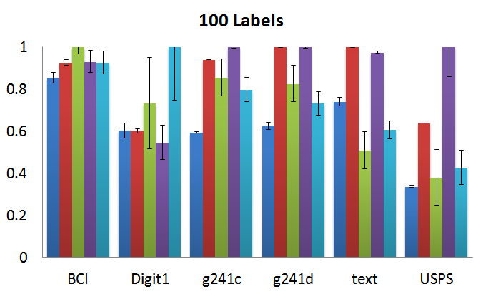
Benchmark Data Sets
Our method + label prop best in 6/12 cases, but not a consistent, significant trend
Seems cut may not be suited for knn graphs

Slide 25
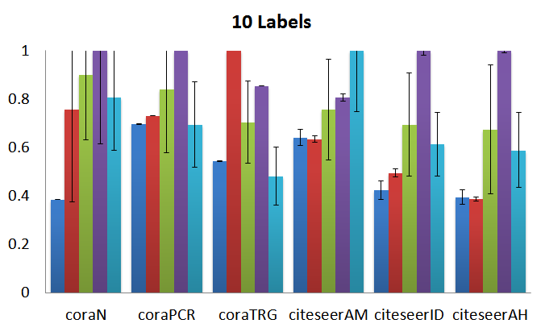
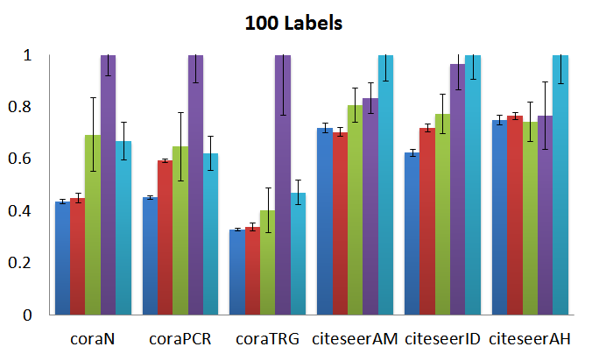
Citation Graph Data Sets
Our method gives consistent, significant benefit
On these data sets the graph is not constructed by us (not knn), so we expect more irregular structure.

Slide 26
Experiments: Movie Recommendation
Which movies should a user rate to get accurate recommendations from collaborative filtering?
We pose this problem as active learning over a hypergraph encoding user preferences, using $Γ(S)$ set to hypergraph cut
Two hypergraph edges for each user:
Hypergraph edge connecting all movies a user likes
Hypergraph edge connecting all movies a user dislikes
Partitions with low hypergraph cut value are consistent (on average) with user preferences

Slide 27
Movies Maximizing Ψ(S)
Movies Rated Most Times
Star Wars Ep. V
Star Wars Ep. VI
Saving Private Ryan
Terminator 2: Judgment Day
The Matrix
Back to the Future
The Silence of the Lambs
Men in Black
Raiders of the Lost Ark
The Sixth Sense
Braveheart
Shakespeare in Love
Star Wars Ep. I
Forrest Gump
Wild Wild West (1999)
The Blair Witch Project
Titanic
Mission: Impossible 2
Babe
The Rocky Horror Picture Show
L.A. Confidential
Mission to Mars
Austin Powers
Son in Law
American Beauty
Star Wars Ep. IV
Jurassic Park
Fargo
Using Movielens data

Slide 28
Our Contributions
A new, more general bound on error parameterized by an arbitrarily chosen submodular function
An active, semi-supervised learning method for approximately minimizing this bound
Proof that minimizing this bound exactly is NP-hard
Theoretical evidence this is the “right” bound
Experimental results

